Slide 1

Introduction to R
Some slides adapated from :
Arin Basu MD MPH
DataAnalytics
dataanalytics@rediffmail.com
http://dataanalytics.objectis.net

Slide 2
What is R
Software for Statistical Data Analysis
Based on S
Programming Environment
Interpreted Language
Data Storage, Analysis, Graphing
Free and Open Source Software
Notes:
R is a software that provides a programming environment for doing statistical data analysis. This software was written by Robert Gentleman and Ross Ihaka and the name of the software bear the name of the creators. It is a free implementation of S, another popular statistical software. R can be effectively used for data storage, data analysis and a variety of graphing functions. R is distributed free and it is an open source software.

Slide 3
Downloading R
R (current version). http://cran.wustl.edu/
Rstudio, a user-friendly way to use R
https://rstudio.com/products/rstudio/download/#download
Notes:
The current version of R is R-2.0.0. The development cycle of R is very rapid, and almost every six months (April and October), new versions of R are out. In between, alpha and beta versions are put on the websites for testing. The source codes and binary versions of R can be downloaded from http://cran.r-project.org. It has many mirrors. In addition to downloading R directly from the website, it can also be obtained on a CD in many linux distributions, and you can also write to me for obtaining R.

Slide 4
Strengths and Weaknesses
Strengths
Free and Open Source
Strong User Community
Highly extensible, flexible
Implementation of high end statistical methods
Flexible graphics and intelligent defaults
Weakness
Steep learning curve
Slow for large datasets
Notes:
R is a great software. It is freely distributed (free both in price as well as in freedom of usage, no restrictions). It has a very strong user community who are ready to help newbies and share information. It has extensive documentation. Best of all, it is extremely scalable, meaning from very low end to very high end, all types of statistical methods can be easily implemented using R. The graphics of R are very flexible and there are many intelligent defaults. Intelligent defaults mean R can guess what you are trying to do and act accordingly.
On the downside, it can be time-consuming to learn to use it effectively. The learning process is slow, sometimes frustrating, but in the end, it is a rewarding experience. However, for very large datasets, R can sometimes be slow, but there are several ways to speed up R. The newer versions are invariably faster than the older ones, so continuous upgrading of the software is a good way to speed things up.

Slide 5
In an R Session…
First, read data from other sources
Use packages, libraries, and functions
Write functions wherever necessary
Conduct Statistical Data Analysis
Save outputs to files, write tables
Save R workspace if necessary (exit prompt)
Notes:
In general, when we work in an R session for doing statistical analysis, we first read the data, then use one or more packages, libraries, or sets of functions to work on the dataset. We can also write our own functions to accomplish specific tasks. We create outputs and create graphs and graphics. Save our work to a file or several files and terminate the R session. For terminate an R session, type “quit()” (note, even quit is a function), and the program asks you if it can save the R session. If you order “yes”, the session is saved as an .Rdata file and is available at a subsequent session.

Slide 6
Specific Tasks
search()
To see which directories and data are loaded, type:
ls()
To see which objects are stored
getwd()
to see your current working directory
Notes:
A better alternative for including datasets for analysis is using the function with(dataset, expressions). For more information and examples, try ?with

Slide 7
Reading data into R
R not well suited for data preprocessing
Preprocess data elsewhere (Excel, etc…)
Easiest form of data to input: .txt file
Spreadsheet like data:
Small/medium size: use read.table()
Large data: use scan()
Notes:
This is the absolute first step of working with R when you want to do statistical data analysis. You may not use this step if you are want to write a program yourself, say, or if you are planning to enter some data yourself. We recommend that you preprocess or “clean” the data elsewhere, using a spreadsheet program (e.g. Microsoft Excel, or OpenOffice Calc), or another software like SPSS, or SAS, and then import into R. However, you can use R to clean and preprocess data, but that may take a longer time than doing preprocessing elsewhere. We recommend that as a beginner, the best way to read data into R is use “scan”, or read.table() functions. Use ?read.table or ?scan within R to learn more about them. Try to convert data into a text file and then input into R. You can use the “foreign” library to import data from other statistical systems (eg SPSS, or Epi Info). If you are working with datasets, use the function “data.frame” or “as.data.frame” for converting your dataset into a dataframe. For example, a typical command could run like:
library(foreign)
mydata <- data.frame(read.spss(“myfile.sav”,use.value.labels=TRUE))
Here, you call the library “foreign” so that you can read data that is stored in a foreign format. Then store that data in the object called “mydata”. You have to remember that you need to give full path of the file that is read in. In this example, the data file was in the same folder as the working directory of R.
Once you have obtained a data frame, you can export it to different file formats. We prefer exporting it to a comma separated or tab delimited file for ease of use. Use the function “write.table” to accomplish the task. See ?write.table in an R session for more information.

Slide 8
Reading Data: summary
Directly using a vector e.g.: x <- c(1,2,3…)
Using scan and read.table function
Using matrix function to read data matrices
Using data.frame to read mixed data
library(foreign) for data from other programs
Notes:
To summarize, you can either type in your own data, using a command like x <- c(2,3,5…) where 2,3,5 represent individual values that are stored in a variable called x. Using similar commands, it is possible to build up a dataset from bottoms up. Other times, you can directly read in data from other software programs as outlined previously. The concepts you learned about the differences between matrix, data frame, lists and vectors will come in handy here.

Slide 9
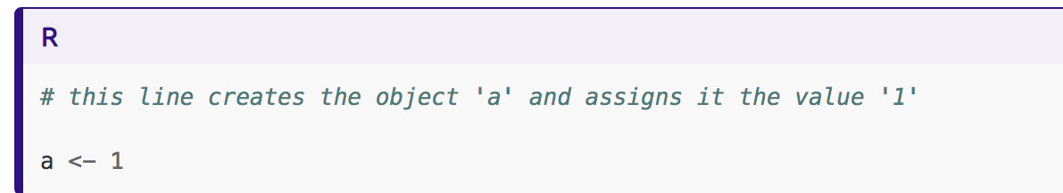
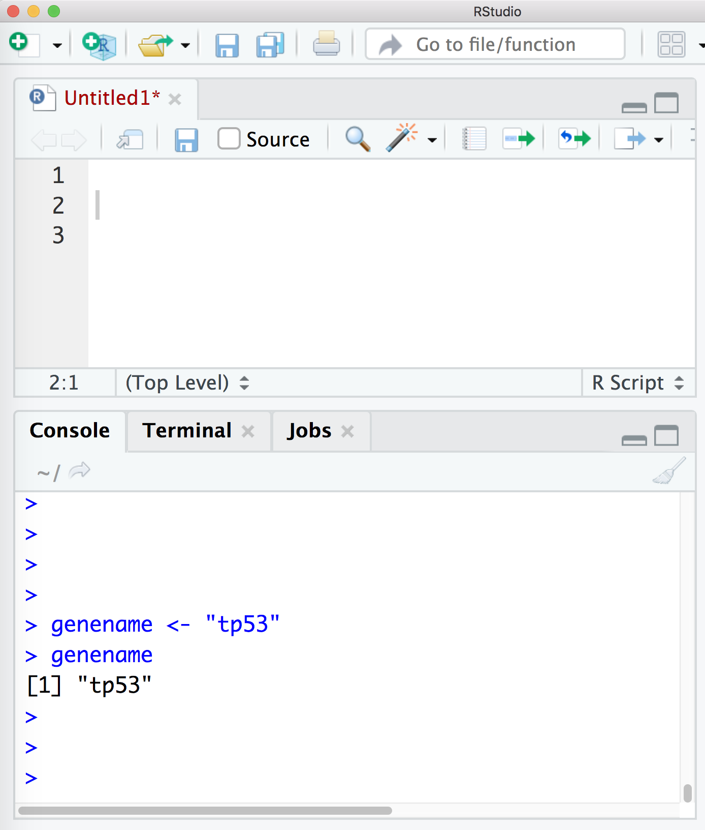

Slide 10
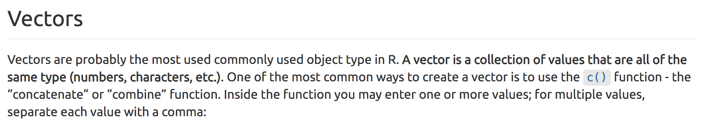
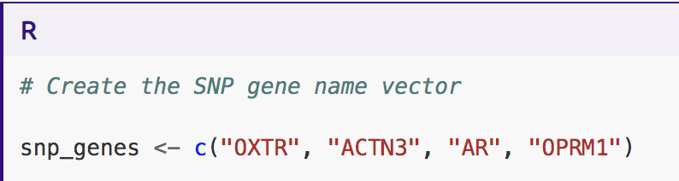

Slide 11
setwd()
Set working directory
getwd()
Get working directory
library()
load package of interest
Notes:
if (!requireNamespace("BiocManager", quietly = TRUE)) install.packages("BiocManager") BiocManager::install("DESeq2")

Slide 12
R Packages for data analysis

Slide 13
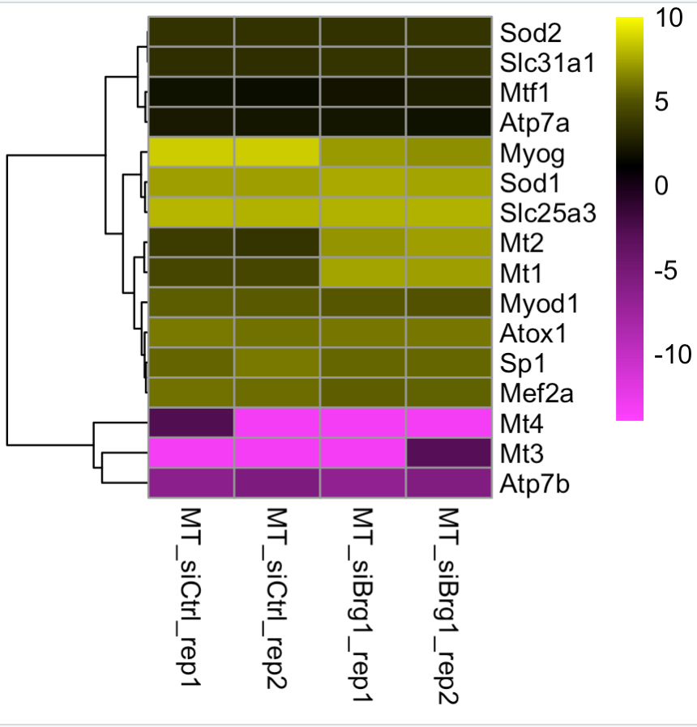
heatmaps
log2s RNA-Seq expression

Slide 14
Prepare RSEM output files for heatmap creation
Copy TPM data into table
Calculate log2TPM of the table (if you have 0 values, convert them to a low decimal value (e.g. 0.0001)
Notes:
if (!requireNamespace("BiocManager", quietly = TRUE)) install.packages("BiocManager") BiocManager::install("DESeq2")

Slide 15
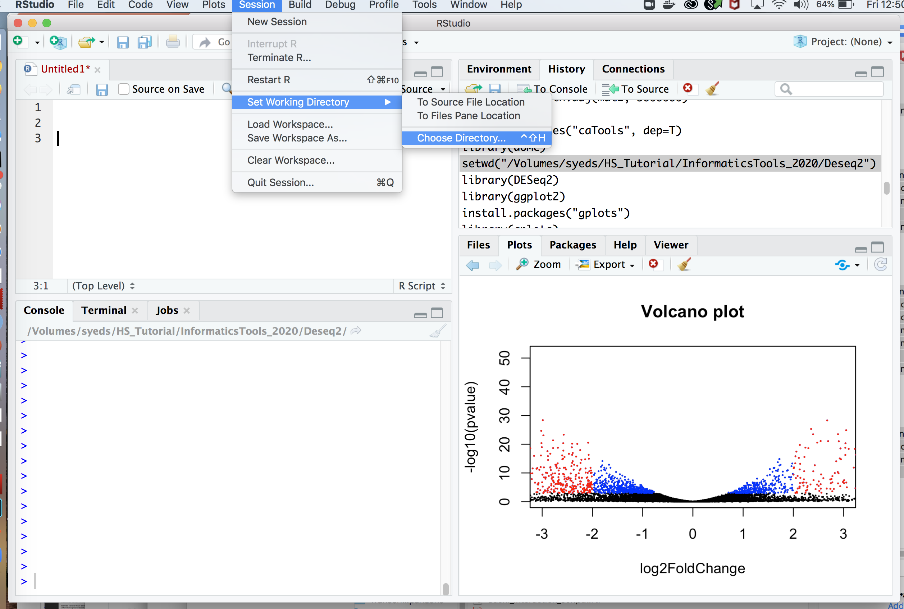

Slide 16
> setwd("where file is located")
> install.packages("gplots")
Try installing RColorBrewer, colorRamps, and pheatmap using Rstudio buttons
Notes:
if (!requireNamespace("BiocManager", quietly = TRUE)) install.packages("BiocManager") BiocManager::install("DESeq2")

Slide 17
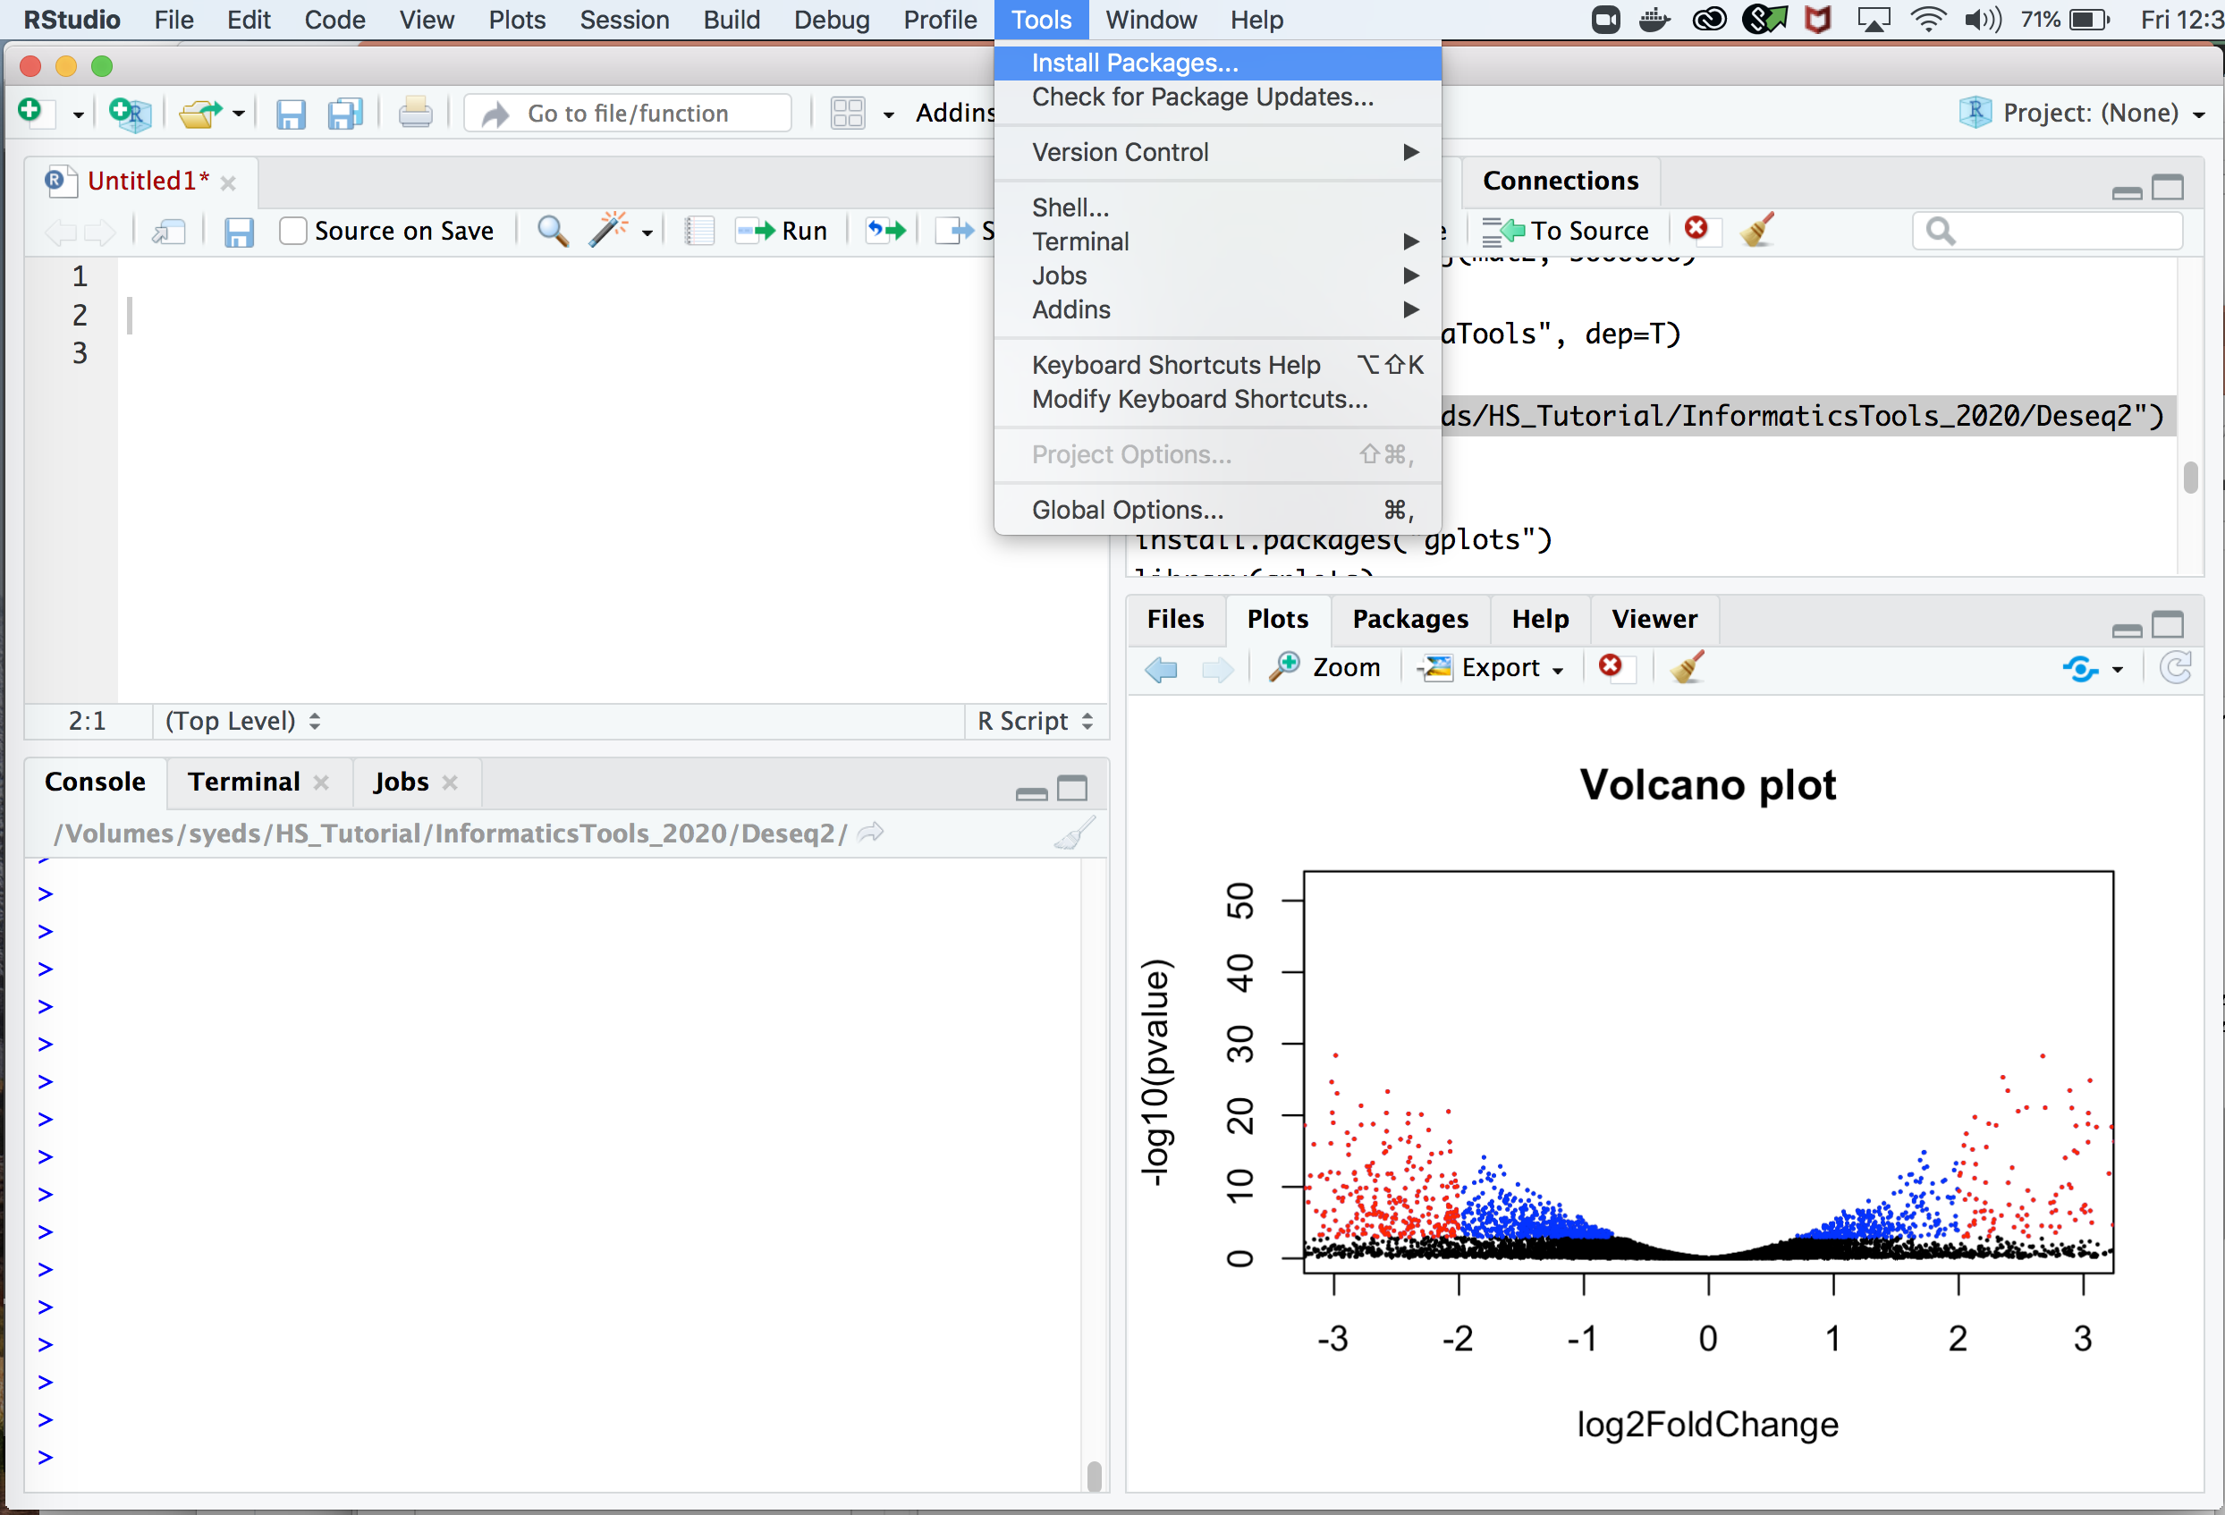

Slide 18
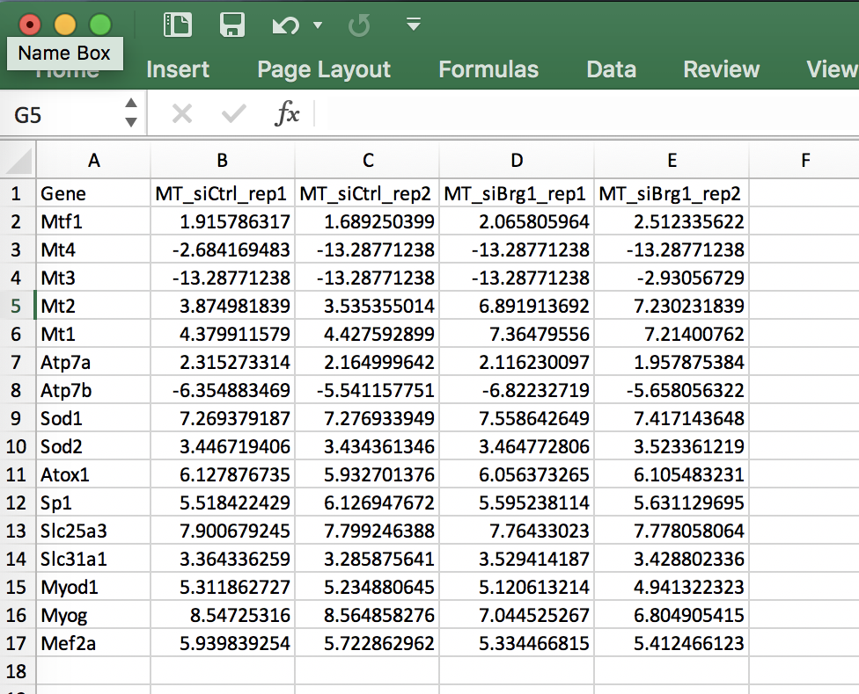
> setwd("where file is located")
> install.packages("gplots")
> library(gplots)
> library(RColorBrewer)
> library(colorRamps)
> library(pheatmap)
> data=read.delim("Kan_genelist_1.txt", sep="\t", row.names="Gene", header=T)
> data_mat=as.matrix(data[,1:4])
> View(data_mat)
row.names ="Gene"
Notes:
if (!requireNamespace("BiocManager", quietly = TRUE)) install.packages("BiocManager") BiocManager::install("DESeq2")

Slide 19
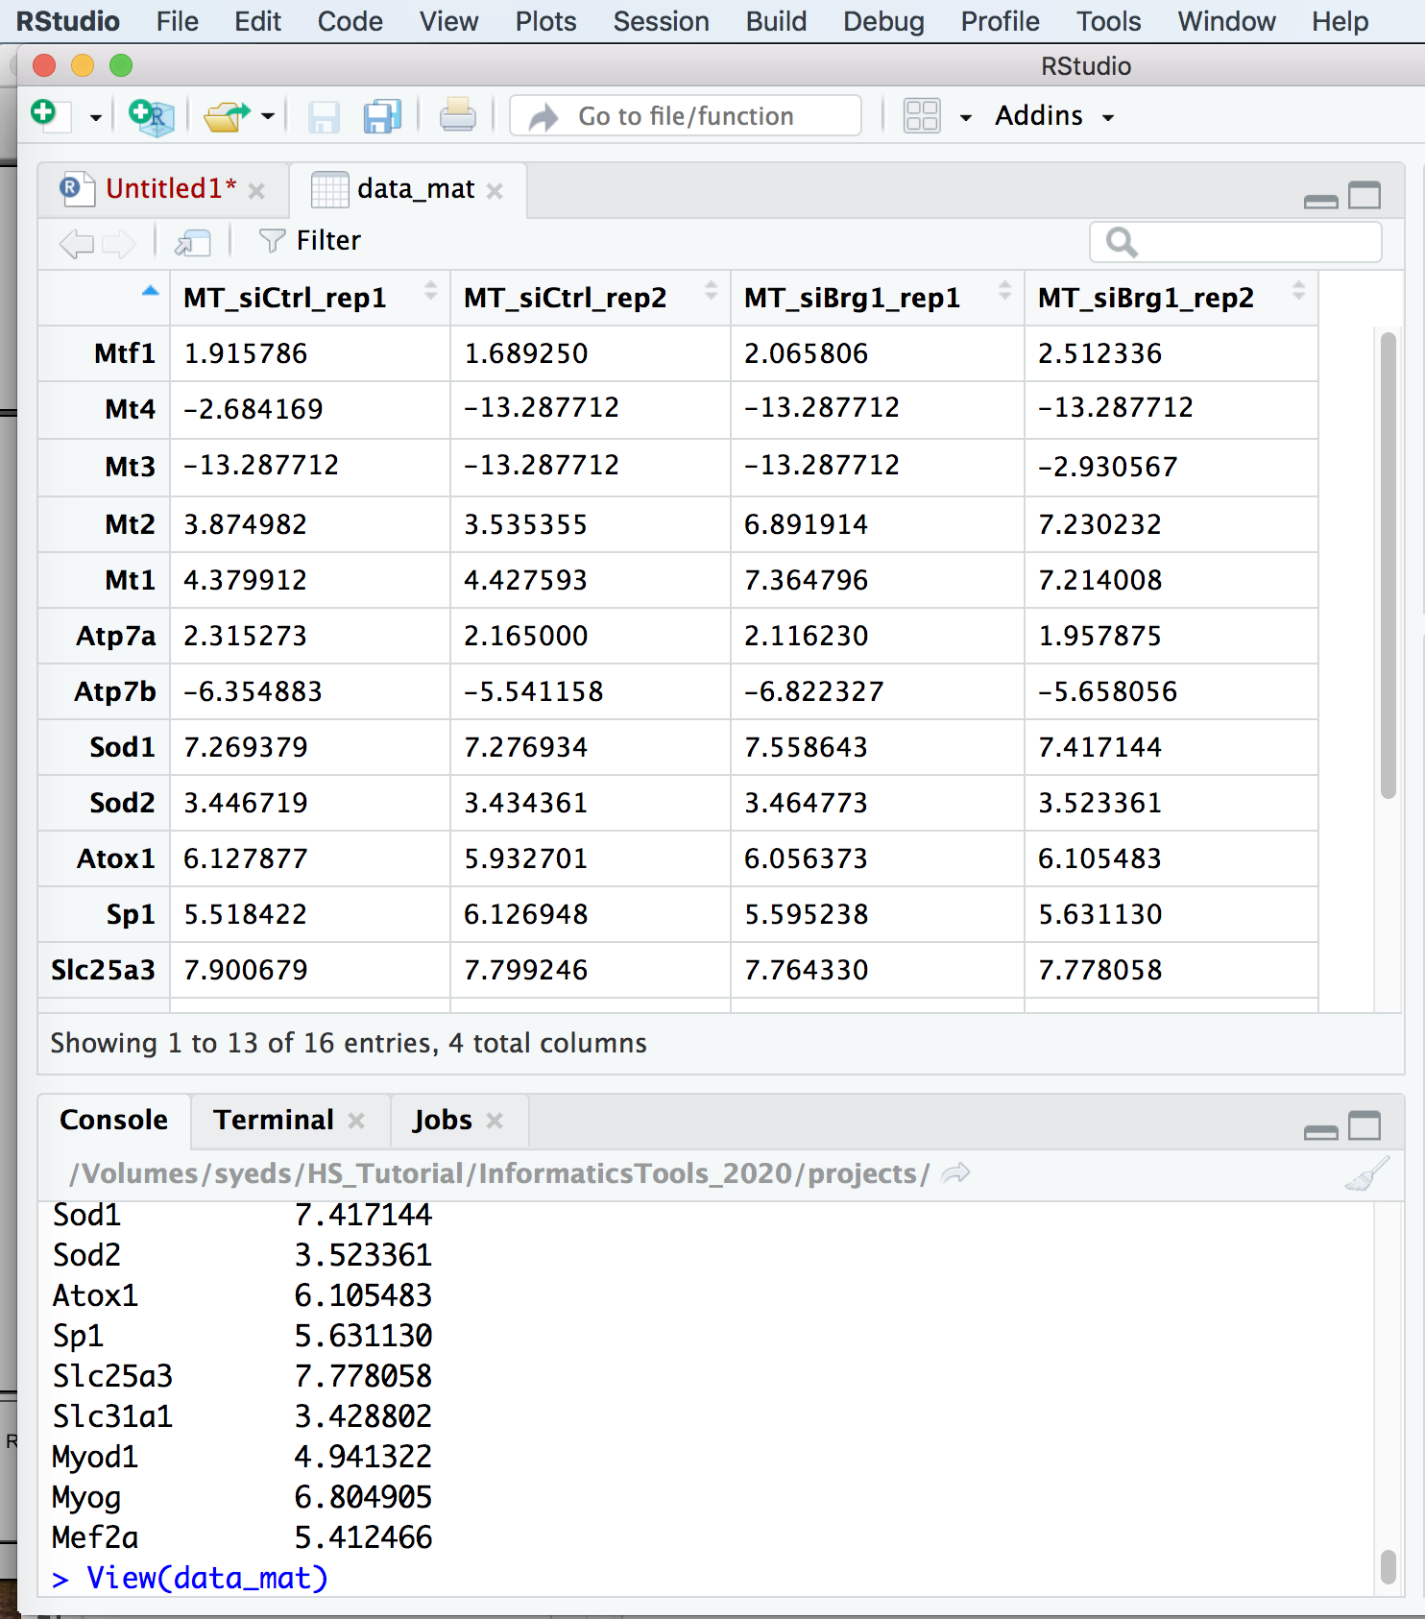
Notes:
if (!requireNamespace("BiocManager", quietly = TRUE)) install.packages("BiocManager") BiocManager::install("DESeq2")

Slide 20
> setwd("where file is located")
> install.packages("gplots")
> library(gplots)
> library(RColorBrewer)
> library(colorRamps)
> library(pheatmap)
>data=read.delim(”log2TPMtable.txt", sep="\t", row.names="Gene", header=T)
> data_mat=as.matrix(data[,1:4])
> View(data_mat)
> pdf(”log2TPMtableheatmap_1.pdf", width=8, height=11)
Optional feature, turn on Pdf maker
Notes:
if (!requireNamespace("BiocManager", quietly = TRUE)) install.packages("BiocManager") BiocManager::install("DESeq2")

Slide 21
> setwd("where file is located")
> install.packages("gplots")
> library(gplots)
> library(RColorBrewer)
> library(colorRamps)
> library(pheatmap)
>data=read.delim(”log2TPMtable.txt", sep="\t", row.names="Gene", header=T)
> data_mat=as.matrix(data[,1:4])
> View(data_mat)
> pdf("log2TPMtableheatmap_1.pdf", width=8, height=11)
> pheatmap(data_mat[1:16,], breaks=c(seq(-14,-1.5, length.out=64),seq(-1.4,2,length.out=64),seq(2.1,10,length.out=64)), cluster_rows = TRUE, cluster_cols = FALSE, color =colorRampPalette(c("magenta", "black", "yellow"))(length(c(seq(-14,-1.5, length.out=64),seq(-1.4,2,length.out=64), seq(2.1,10,length.out=64)))))
Notes:
if (!requireNamespace("BiocManager", quietly = TRUE)) install.packages("BiocManager") BiocManager::install("DESeq2")

Slide 22
Must identify how many rows in your dataset
> pheatmap(data_mat[1:16,], breaks=c(seq(-14,-1.5, length.out=64),seq(-1.4,2,length.out=64),seq(2.1,10,length.out=64)), cluster_rows = TRUE, cluster_cols = FALSE, color =colorRampPalette(c("magenta", "black", "yellow"))(length(c(seq(-14,-1.5, length.out=64),seq(-1.4,2,length.out=64), seq(2.1,10,length.out=64)))))
> dev.off()
Notes:
if (!requireNamespace("BiocManager", quietly = TRUE)) install.packages("BiocManager") BiocManager::install("DESeq2")

Slide 23
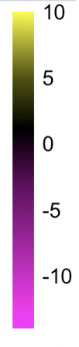
Define the range of log2TPM values and when you want the colors to start transitioning
> pheatmap(data_mat[1:16,], breaks=c(seq(-14,-1.5, length.out=64),seq(-1.4,2,length.out=64),seq(2.1,10,length.out=64)), cluster_rows = TRUE, cluster_cols = FALSE, color =colorRampPalette(c("magenta", "black", "yellow"))(length(c(seq(-14,-1.5, length.out=64),seq(-1.4,2,length.out=64), seq(2.1,10,length.out=64)))))
> dev.off()
Notes:
if (!requireNamespace("BiocManager", quietly = TRUE)) install.packages("BiocManager") BiocManager::install("DESeq2")

Slide 24
Clustering options
> pheatmap(data_mat[1:16,], breaks=c(seq(-14,-1.5, length.out=64),seq(-1.4,2,length.out=64),seq(2.1,10,length.out=64)), cluster_rows = TRUE, cluster_cols = FALSE, color =colorRampPalette(c("magenta", "black", "yellow"))(length(c(seq(-14,-1.5, length.out=64),seq(-1.4,2,length.out=64), seq(2.1,10,length.out=64)))))
> dev.off()
Notes:
if (!requireNamespace("BiocManager", quietly = TRUE)) install.packages("BiocManager") BiocManager::install("DESeq2")

Slide 25
> pheatmap(data_mat[1:16,], breaks=c(seq(-14,-1.5, length.out=64),seq(-1.4,2,length.out=64),seq(2.1,10,length.out=64)), cluster_rows = TRUE, cluster_cols = FALSE, color =colorRampPalette(c("magenta", "black", "yellow"))(length(c(seq(-14,-1.5, length.out=64),seq(-1.4,2,length.out=64), seq(2.1,10,length.out=64)))))
> dev.off()
Define the colors you want for the legend
Notes:
if (!requireNamespace("BiocManager", quietly = TRUE)) install.packages("BiocManager") BiocManager::install("DESeq2")

Slide 26
> pheatmap(data_mat[1:16,], breaks=c(seq(-14,-1.5, length.out=64),seq(-1.4,2,length.out=64),seq(2.1,10,length.out=64)), cluster_rows = TRUE, cluster_cols = FALSE, color =colorRampPalette(c("magenta", "black", "yellow"))(length(c(seq(-14,-1.5, length.out=64),seq(-1.4,2,length.out=64), seq(2.1,10,length.out=64)))))
> dev.off()
Turn off pdf maker
Notes:
if (!requireNamespace("BiocManager", quietly = TRUE)) install.packages("BiocManager") BiocManager::install("DESeq2")

Slide 27
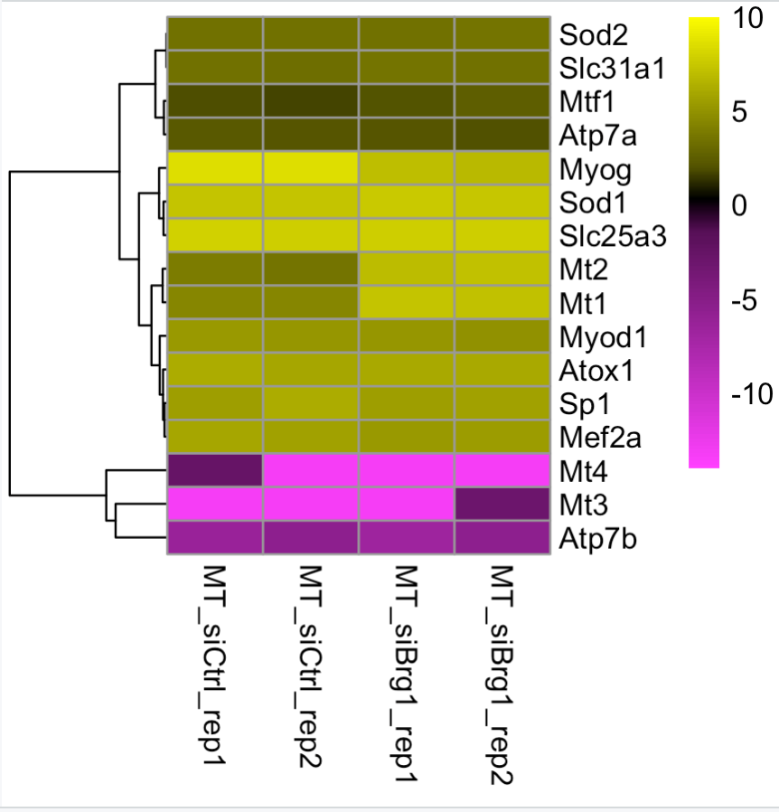
Notes:
if (!requireNamespace("BiocManager", quietly = TRUE)) install.packages("BiocManager") BiocManager::install("DESeq2")

Slide 28
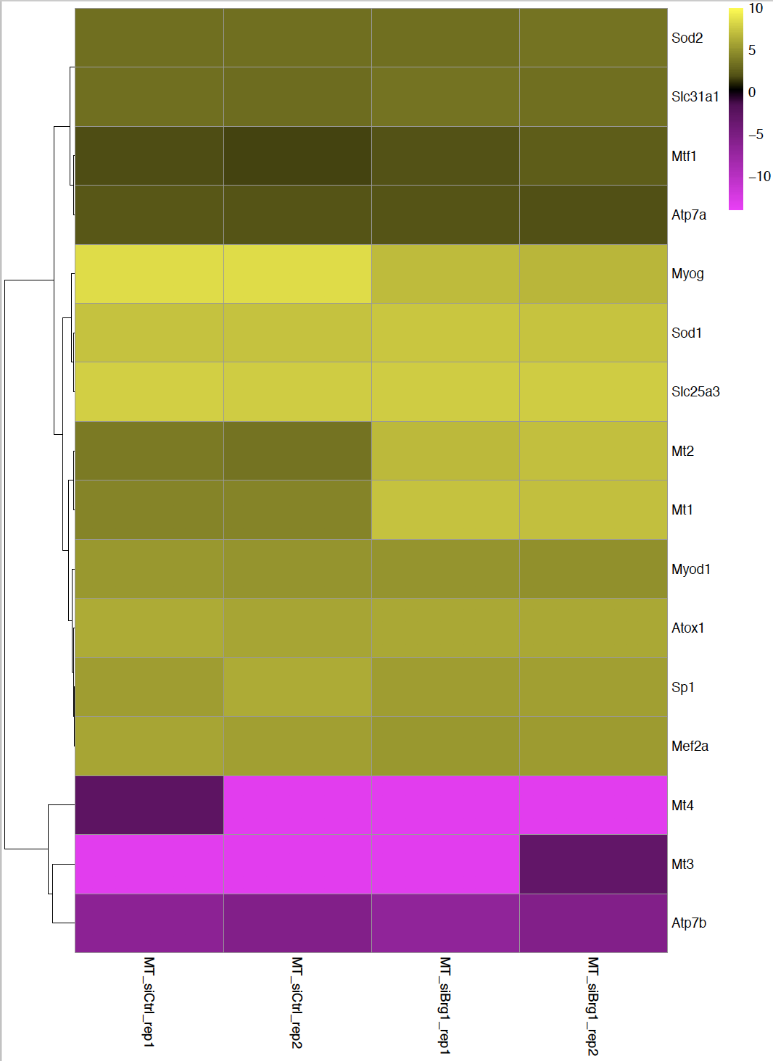
Made with Pdf maker option
Copied from Rstudio window
Notes:
if (!requireNamespace("BiocManager", quietly = TRUE)) install.packages("BiocManager") BiocManager::install("DESeq2")

Slide 29
R Packages for data analysis

Slide 30
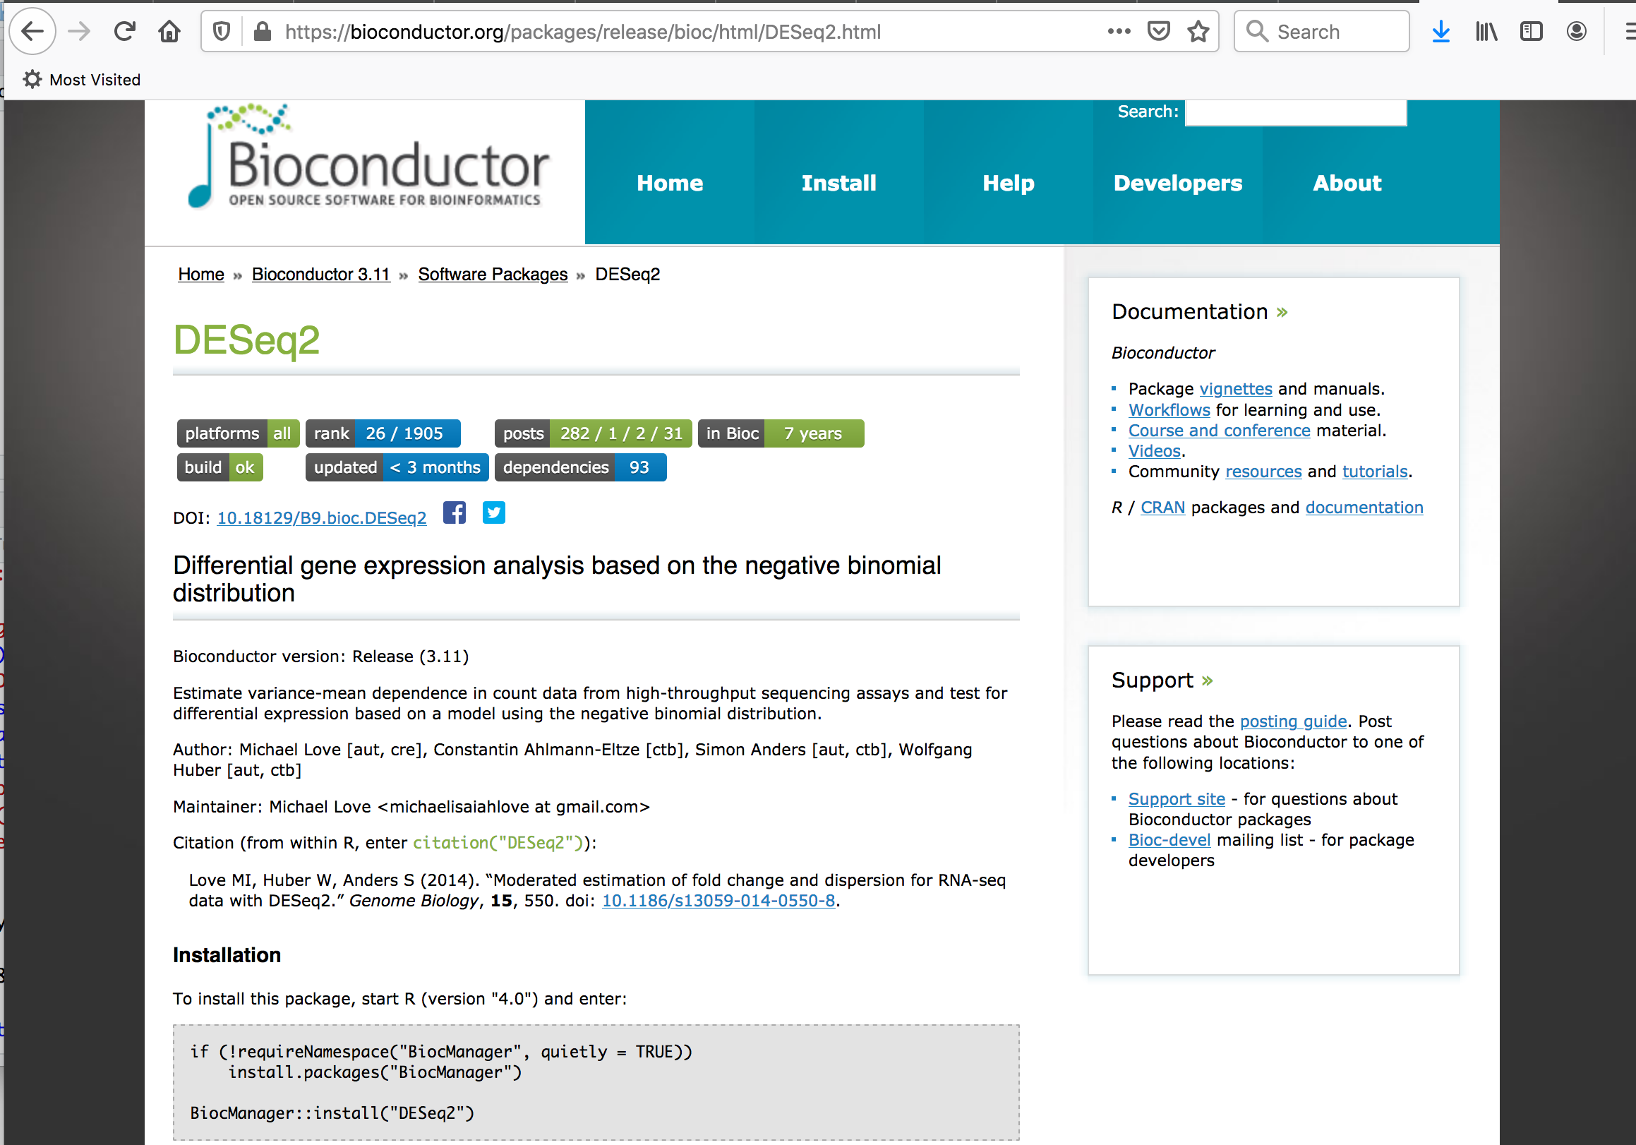
https://bioconductor.org/packages/release/bioc/html/DESeq2.html
Notes:
if (!requireNamespace("BiocManager", quietly = TRUE)) install.packages("BiocManager") BiocManager::install("DESeq2")

Slide 31
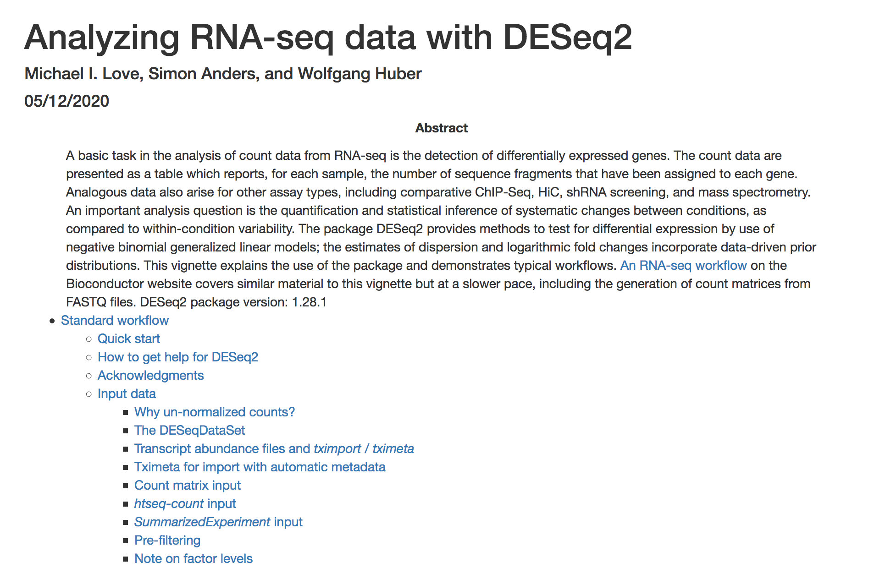
https://bioconductor.org/packages/release/bioc/vignettes/DESeq2/inst/doc/DESeq2.html

Slide 32
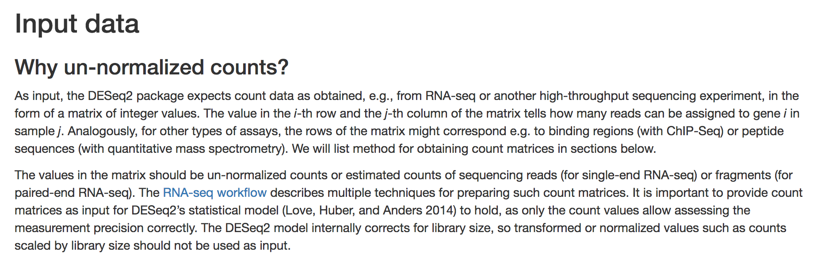
https://bioconductor.org/packages/release/bioc/vignettes/DESeq2/inst/doc/DESeq2.html

Slide 33
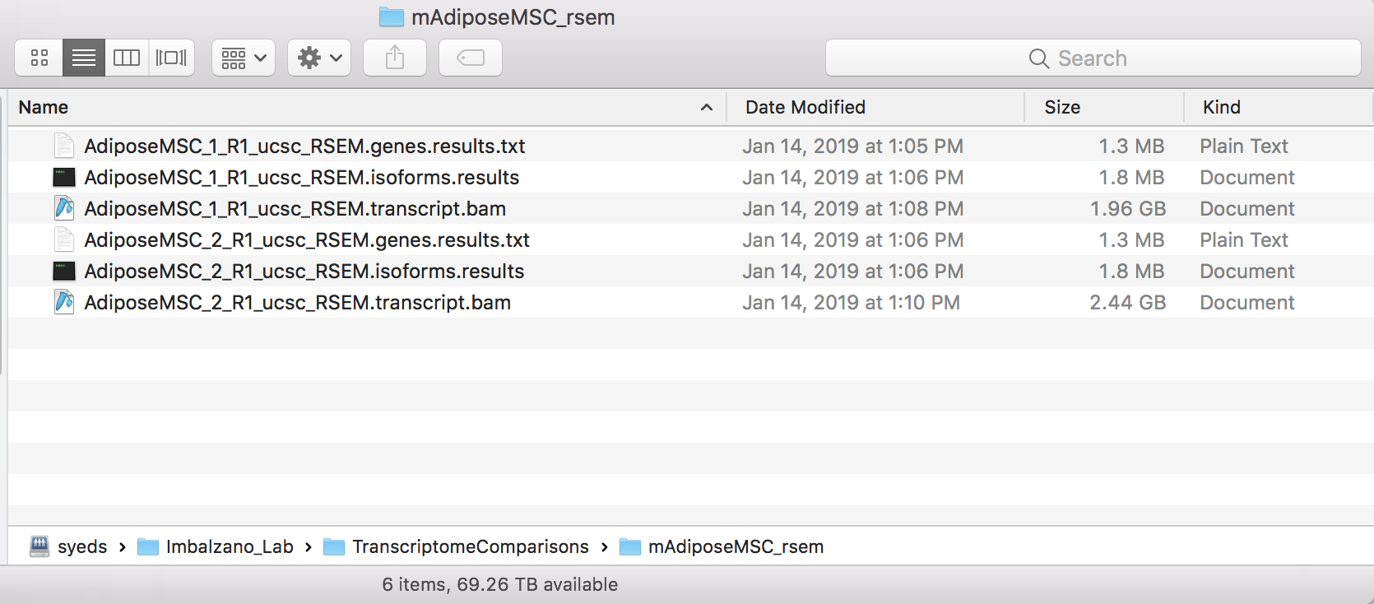
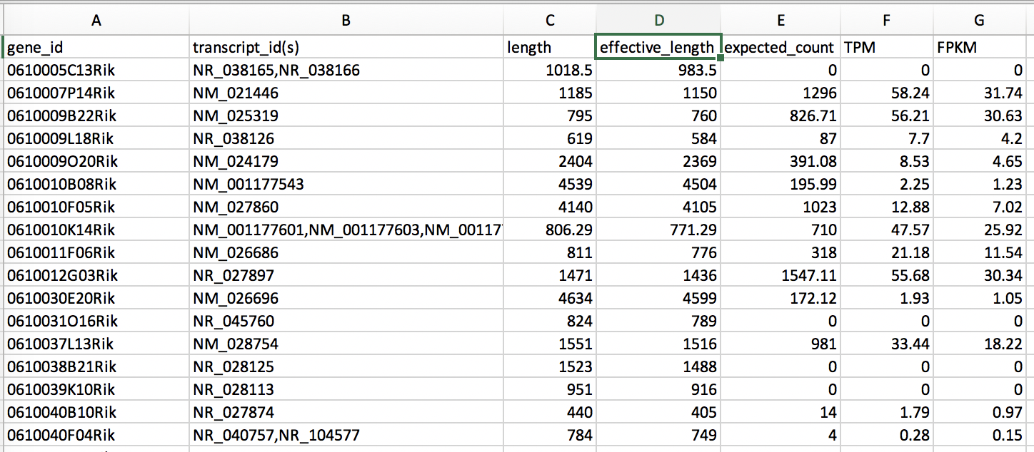
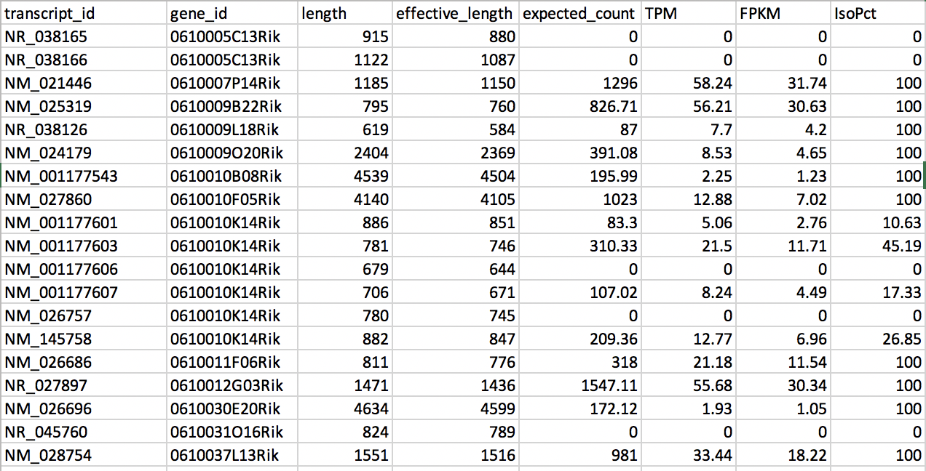
RSEM output
Gene results
Transcript variant results

Slide 34
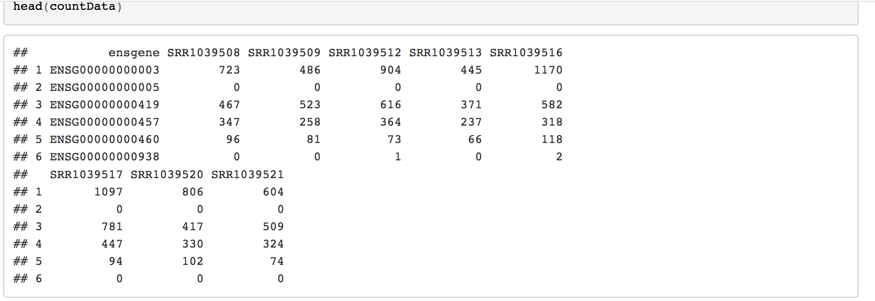
Prepare RSEM output files for Differential Gene Expression analysis
Copy counts data into table
***NOTE, excel alters genes Marc1, Marc2 and March1, March2 to 03-01-20 so keep any eye on these gene names if you receive an error about duplicates.

Slide 35
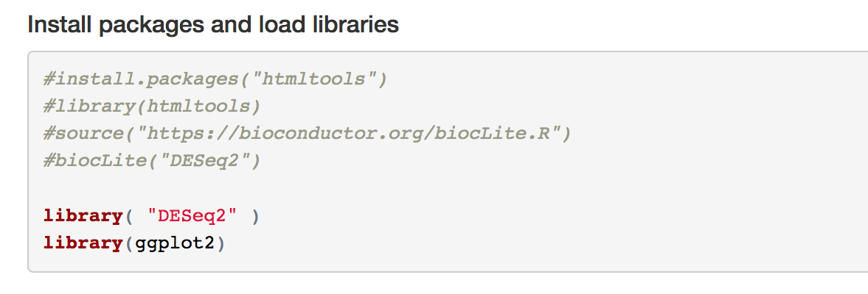
DESeq2 Tutorial
https://lashlock.github.io/compbio/R_presentation.html

Slide 36
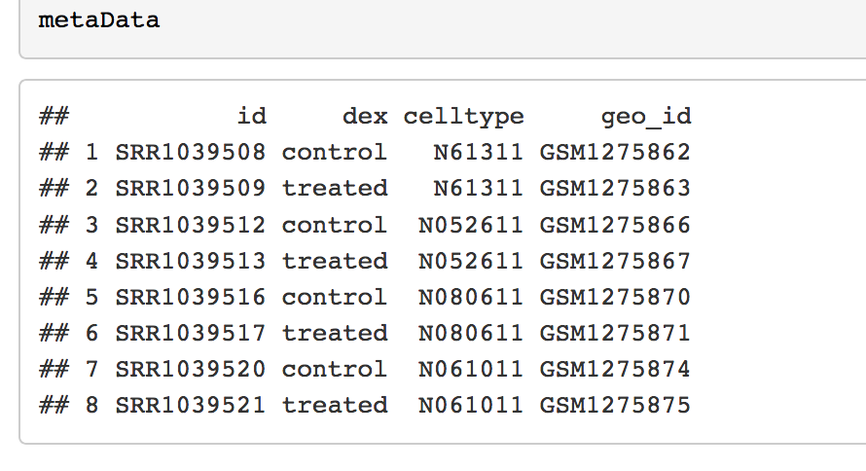
Example of a metadata file that describes the experiment and replicates

Slide 37
RSEM Script
> file <- "D0vsD1_3T3L1_RSEM_counts_nodup.txt"
> file2 <- "metadata.txt"

Slide 38
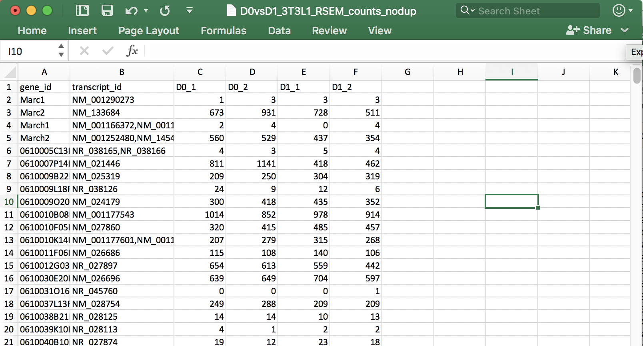
file <- "D0vsD1_3T3L1_RSEM_counts_nodup.txt"
***NOTE, excel alters genes Marc1, Marc2 and March1, March2 to 03-01-20 so keep an eye on these gene names if you receive an error about duplicates.

Slide 39
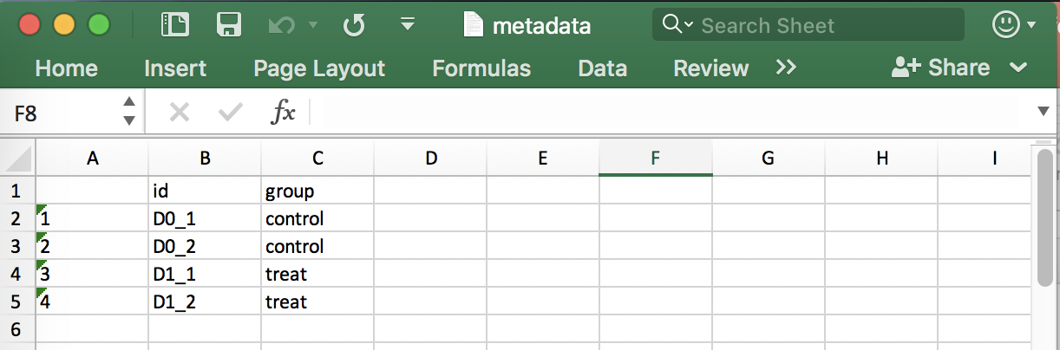
file2 <- "metadata.txt"

Slide 40
RSEM Script
Load the RSEM_counts and the experimental metadata files
> file <- "D0vsD1_3T3L1_RSEM_counts_nodup.txt"
> file2 <- "metadata.txt"
Convert those files into R tables
> rsem <- read.table(file , sep="\t", header=TRUE, row.names=1)
> metadata <- read.table(file2 , sep="\t", header=TRUE, row.names=1)

Slide 41
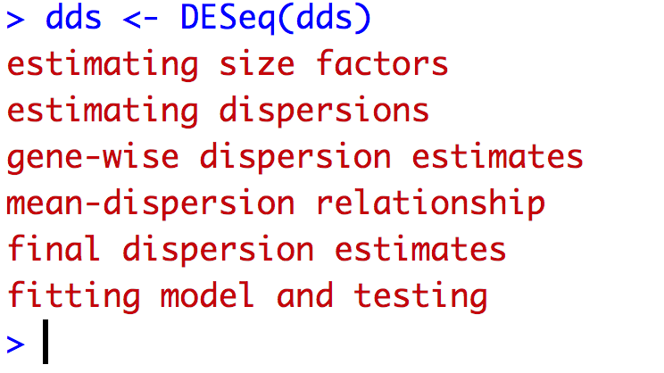
Construct DESEQDataSet Object
> dds <- DESeqDataSetFromMatrix(countData=rsem, colData=metaData, design=~group, tidy = TRUE)
Run the DESEQ function
> dds <- DESeq(dds)
Export Results
> res <- results(dds)
> write.table(res, file="3T3-L1_D0vsD1_DESeq_FCanalysis.txt", sep="\t")

Slide 42
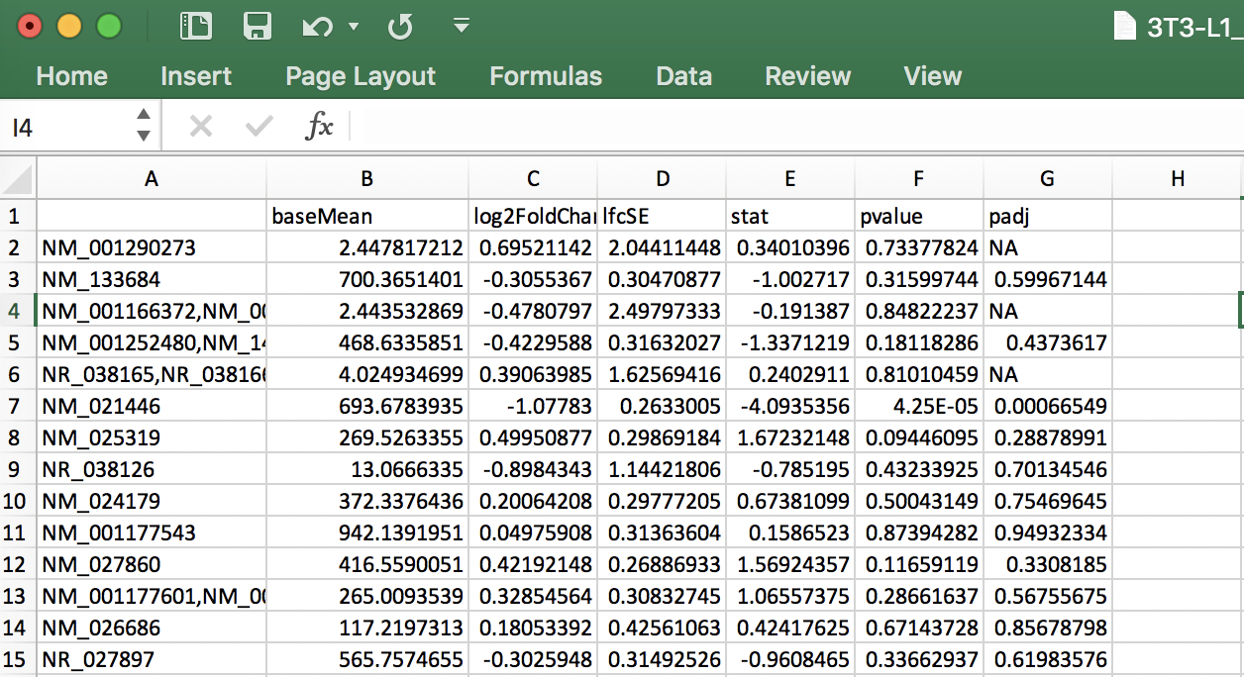
DESeq2 output: log2FoldChange calculation and statistics
baseMean = normalized average read count.
log2foldchange
lfcSE = the standard error estimate for the log2 fold change estimate.
stat = wald statistic (the Wald test is the default used for hypothesis testing when comparing two groups. The Wald test is a test of hypothesis usually performed on parameters that have been estimated by maximum likelihood.
p-value = non adjusted pvalue.
p-value adjusted (padj) column contains the p-values, adjusted for multiple testing with the Benjamini-Hochberg procedure (see the standard R function p.adjust), which controls false discovery rate (FDR) . It’s possible to restrict the result for the ones which are under a fixed FDR cut-off. Example : A FDR adjusted p-value (or q-value) of 0.05 implies that 5% of significant tests will result in false positives.

Slide 43
Volcano Plot
#reset par
par(mfrow=c(1,1))
# Make a basic volcano plot
with(res, plot(log2FoldChange, -log10(pvalue), pch=20, cex=0.3, main="Volcano plot", xlim=c(-3,3)))
# Add colored points: blue if padj<0.01, red if log2FC>1 and padj<0.05
with(subset(res, padj<.01 ), points(log2FoldChange, -log10(pvalue), pch=20, cex=0.3, col="blue"))
with(subset(res, padj<.01 & abs(log2FoldChange)>2), points(log2FoldChange, -log10(pvalue), pch=20, cex=0.3, col="red"))

Slide 44
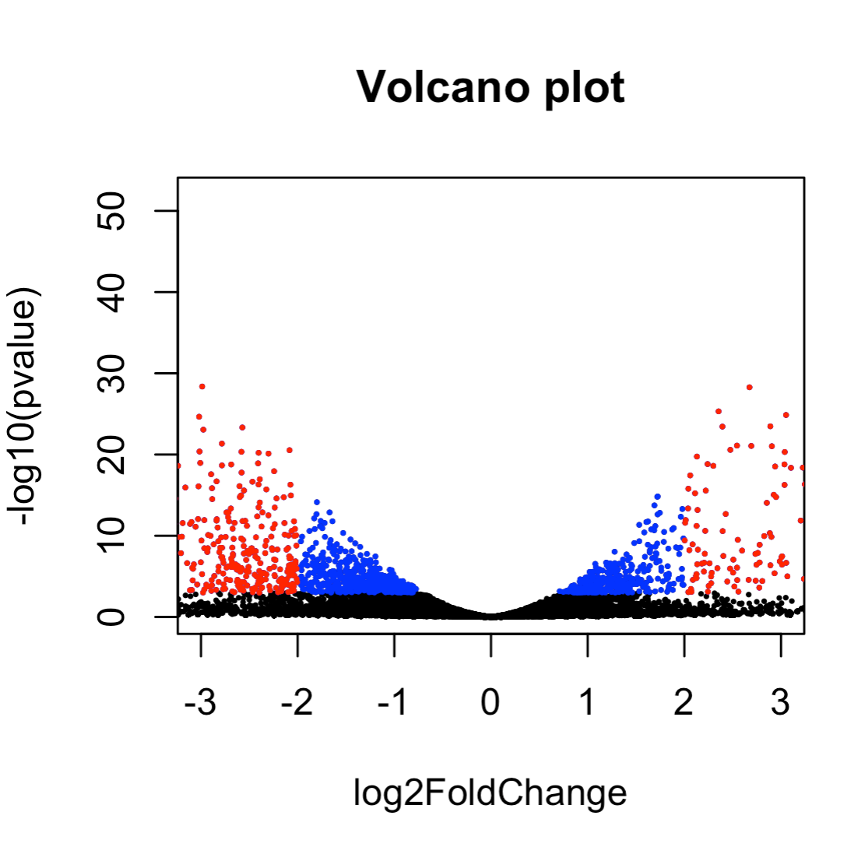
For labeling genes on a volcano plot
> library(dplyr)
> library(ggplot2)
> library(ggrepel)
Read blogs: https://gettinggeneticsdone.blogspot.com/2014/05/r-volcano-plots-to-visualize-rnaseq-microarray.html
https://gettinggeneticsdone.blogspot.com/2016/01/repel-overlapping-text-labels-in-ggplot2.html

